Slide 1
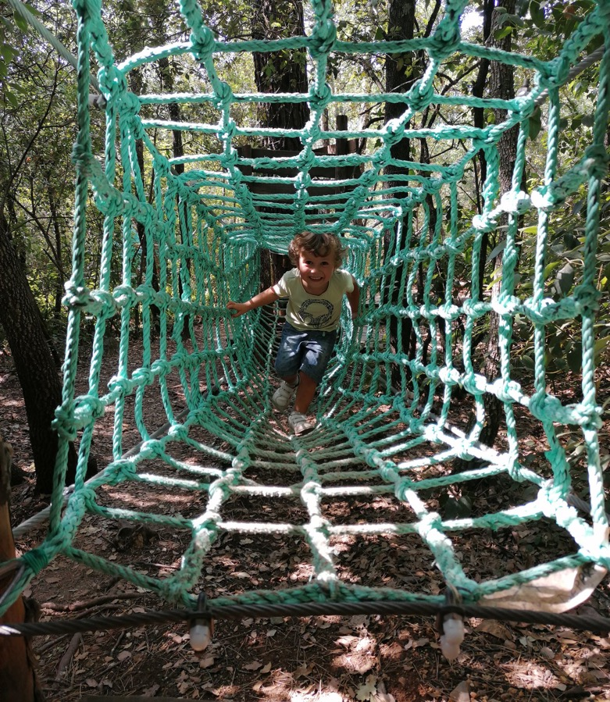
EUROPEAN GOOD PRACTICES GUIDE
Selection of inspiring practices in youth initiatives in the field of eco-health tourism.
https://ecohealthforyouth.com

Slide 2
TABLE OF CONTENTS
Introduction
Methodology
Classification of the case studies
04
The partners
05
Thanks

Slide 3
INTRODUCTION
The Grassroots project
This good practice guide has been produced in the framework of the Grassroots project. This is a three-year Erasmus+ project that started on 1 May 2022. It brings together 7 European partners.
GRASSROOTS wants to take advantage of ecotourism entrepreneurship as an emerging and powerful trend. The eco-health tourism market is growing rapidly and promises particularly innovative career opportunities for young people, who are more environmentally aware than their elders. Eco-tourism is largely absent from entrepreneurship education but particularly from youth education.
Eco-tourism offers spaces for young people to express their talents. We have identified together with them three areas of work that they can invest in: sport, street food, street art and digital. Eco-tourism is largely absent in entrepreneurship education. Research conducted by the partners in their own countries confirms that 85 of vocational entrepreneurship education is focused on traditional business sectors.
In this context, our project has a clear objective to introduce new models of entrepreneurship education through actions in the field of eco-health tourism.
GRASSROOTS aims to introduce new models, skills, experiential learning, collaborative conversations, exchange of best practices, and formal and informal entrepreneurship education to youth in the fields of eco-tourism sport, street food, street art and digitalisation

Slide 4
METHODOLOGY
Who is this guide for?
This guide is intended for youth educators and can be used to highlight eco-tourism entrepreneurship opportunities to the young people they work with.
This guide aims to present various initiatives that have been developed by different actors: their way of working in eco-health tourism and who they want to involve.
They are all are examples of entrepreneurship in eco-health tourism and can inspire young people to start an eco-health tourism activity or inspire those you accompany.
Who was interviewed?
This guide has been designed to provide a variety of different initiatives considered good practice in eco-tourism.
The target audiences and groups are from different types of eco-tourism businesses:
Actors of the eco-health tourism sector;
Educators of entrepreneurship education through sport, food, and heritage enhancement (business centres, business incubators, social spaces, cultural spaces...) ;
Community-based organisations ;
The structure has been identified locally by the French, Italian, Swedish, Belgian and Irish partners.

Slide 5
METHODOLOGY
To present these organisations, guidelines were sent to each project leader to collect key information. The interview questionnaire was prepared in advance by the project partners and validated by the consortium. Each of the partners has chosen inspiring practices involving young people in the field of eco-health tourism to conduct the interview.
The questions concerned :
- the birth of the project, its objectives and challenges;
- the beneficiaries of the project: their profile, problems, needs and expectations;
- the strategy adopted by the organisation to solve the identified problem addressed by the project;
- the organisation's business model;
- why this is good practice in the field of inclusive tourism.
The partners conducted interviews with the project’s initiator to highlight various eco-health tourism initiatives especially to inspire and advise those who would like to start their own business in this field.
The goals of these interviews were to understand why and how eco-health tourism is suitable for developing the entrepreneurial skills of young NEETs and also to introduce new models of entrepreneurial support

Slide 6
CLASSIFICATION OF THE CASE STUDIES
All the projects identified are very different by nature. To classify them, they have been divided into three different categories:
EXPLORING
« To explore » means to travel by examining or seeking to discover. We have grouped in this category the initiatives which, in a therapeutic dimension, aim to enable participants to find well-being for themselves while exploring nature.
Projects in this category focus on mental well-being tourism
STAYING FIT
We have gathered in this category the inspiring case studies that highlight tourism activities based on discovering nature through physical activity. These activities take place outdoors and are both ways of getting active, through sports, and also of getting to know the environment.
Projects in this category focus on physical well-being tourism
CONNECTING
This category aims to bring together projects connecting people. The connection between tourists and locals is an essential element of eco-tourism. It is a way of showcasing the heritage and know-how of tourist destinations. The notion of sharing is essential in this category dedicated to connection.
Projects in this category focus on social well-being and tourism
PRESERVING NATURE
These projects are particularly committed to ecology and environmental protection, which is a driving force behind eco-health tourism.
Projects in this category focus on ecological tourism

Slide 7
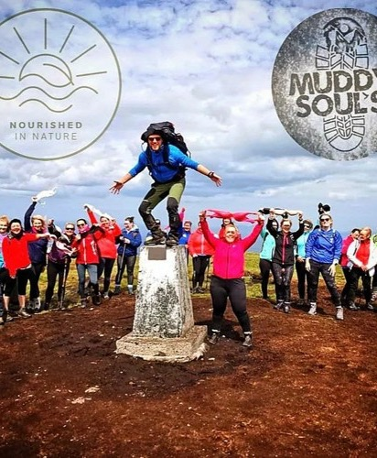



Muddy Souls
Ireland
Outdoor Adventure Wellbeing Escapes in Nature
EXPLORING
Paul Rooney, Entrepreneur
Introduction
Muddy Souls is about well-being and Escapes in nature. Paul is an expert nature and mountain guide bringing people on amazing hikes up some of the most amazing Irish mountains while at the same time helping them improve their mental health.
Mental health and well-being are key to Muddy Souls’ experiences, Paul believes true healing occurs in the natural environment. He brings people where they can feel free, feel the benefits of nature and learn and appreciate all its beauty and complexity. Paul ensures his customers feel like they have accomplished something they never thought they would. He makes sure they feel a real sense of pride getting them out of their comfort zones and helping them overcome a challenging adventure battling all the elements, and terrain and pushing their physical capabilities to the max.
Paul’s Tours covers any mountain within the 32 Irish counties. He tells amazing stories and educates his customers about nature, wildlife, history and the area. He makes sure to bring guests to amazing panoramic views where their breath is taken away and they truly feel alive and invigorated.
Click to Read his Blog and his Story Irish Born, Leitrim Bred but Reared in Nature

Slide 8
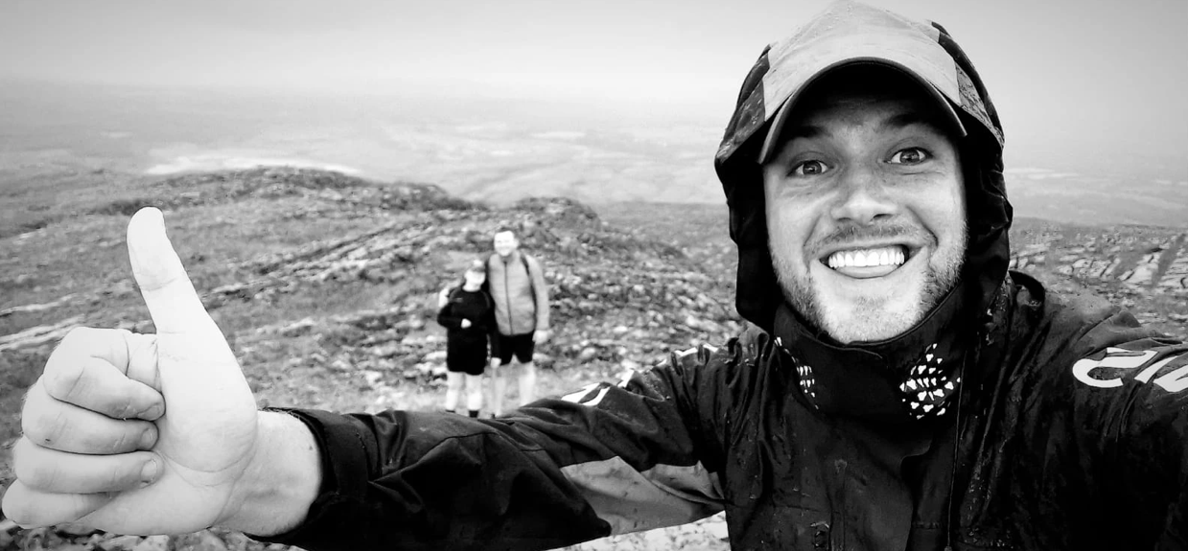
“
I had gone through some mental health and depression periods in my life. I soon realized how powerful nature was, after a few adventures it allowed me to heal by escaping and immersing myself in nature and letting go of everything.
“
Paul Rooney,
Muddy Souls
What Was the Trigger for Your Business or Entrepreneurial Idea?
I had gone through some mental health and depression periods in my life. The health benefits were so important for my mental health too. It improved my physical well-being, boosted my mood, reduced my stress, calmed my anxiety and I was able to stop overthinking.
When I talked to other people, especially men I realized they were going through the same thing and felt helpless like I did. I wanted to show them and other people the power of nature, being in the outdoors, discovering waterfalls, animals and forests, seeing amazing panoramic views how the benefits of these beautiful places and the expedition would profoundly help them even regardless if they were going through a bad time or not.
How Does The Business Help To Address Eco, Climate Change Or Sustainability Issues?
I live by the Leave No Trace 7 Principles and Guidelines to protect and enjoy the outdoors for generations to come.
These simple measures mean everyone can still enjoy the outdoors but so can others, and of course future generations to come. Making a difference even very small and with the simplest of actions can make such an impact on our environments. When I am organizing a trip, tour or expedition I always inform my customers about how they can minimize the impact on the environment e.g., coming by carpool, don’t leave any rubbish behind, don’t go where you're not supposed to go and respect other peoples land, don’t be noisy, let others pass, don’t disturb or take away from heritage and cultural sites. Here is one of the Leave No Trace guides I follow so I am up to speed, have the skills I need and know what I can sustain the environment.

Slide 9
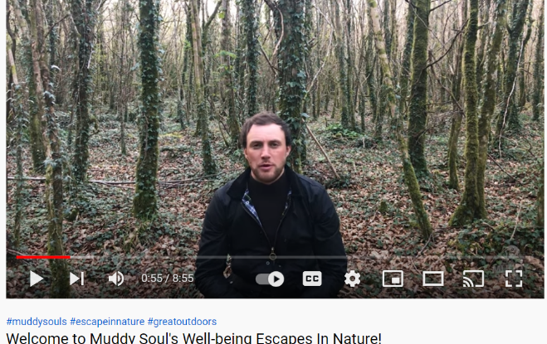
How are You Innovative in Eco-Health and Adventure? How Did You Start Your Business?
I believe my hikes provide the best medicine going – to nature and the outdoors. I believe nature is an untapped source to improve particularly mental and physical health. People have said to me after one of my trips ‘I feel like I have taken my first ever proper breath’. I work with other tour companies and adventure guides. Creating this network is so important to all of our businesses. We work together to develop packages and most of our bookings are done online. We offer packages that include foraging, glamping and well-being therapies. We educate our guests and make sure they feel the magic of nature and are hungry to come back for more or tell others.
Digital wise Wix website builder was a game changer for me. Its API capability meant developing my website has been so easy, especially when I had no idea how to build a website. I have even added a book tours section, events and merchandise store etc. I also use Canva for video production and designing my marketing collateral. My drone is my go-to tool for the ultimate videos and images, making my experiences visually come to life.

Slide 10
How are You Innovative in Eco-Health and Adventure? How Did You Start Your Business?
I believe my hikes provide the best medicine going – to nature and the outdoors. I believe nature is an untapped source to improve particularly mental and physical health. People have said to me after one of my trips ‘I feel like I have taken my first ever proper breath’. I work with other tour companies and adventure guides. Creating this network is so important to all of our businesses. We work together to develop packages and most of our bookings are done online. We offer packages that include foraging, glamping and well-being therapies. We educate our guests and make sure they feel the magic of nature and are hungry to come back for more or tell others.
Digital wise Wix website builder was a game changer for me. Its API capability meant developing my website has been so easy, especially when I had no idea how to build a website. I have even added a book tours section, events and merchandise store etc. I also use Canva for video production and designing my marketing collateral. My drone is my go-to tool for the ultimate videos and images, making my experiences visually come to life.

Slide 11
How are You Innovative in Eco-Health and Adventure? How Did You Start Your Business?
I believe my hikes provide the best medicine going – to nature and the outdoors. I believe nature is an untapped source to improve particularly mental and physical health. People have said to me after one of my trips ‘I feel like I have taken my first ever proper breath’. I work with other tour companies and adventure guides. Creating this network is so important to all of our businesses. We work together to develop packages and most of our bookings are done online. We offer packages that include foraging, glamping and well-being therapies. We educate our guests and make sure they feel the magic of nature and are hungry to come back for more or tell others.
Digital wise Wix website builder was a game changer for me. Its API capability meant developing my website has been so easy, especially when I had no idea how to build a website. I have even added a book tours section, events and merchandise store etc. I also use Canva for video production and designing my marketing collateral. My drone is my go-to tool for the ultimate videos and images, making my experiences visually come to life.

Slide 12
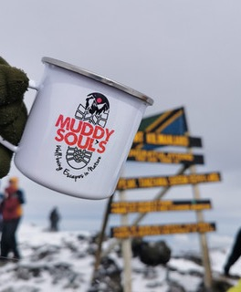
“
The Biggest Thing Between You and That Mountain is You
Wander Deep Into Nature and Understand Everything Better!
“
Paul Rooney
Founder and Owner of Muddy Souls
How Successful Has It Been?
My business has been successful so far because I believe I am trying to do something different and beneficial to people’s overall health.
I have remained focused on this competitive advantage and of course, the business side of things can’t be neglected. My success to date has been based on a mixture of many things; building my skills through training and mentoring. As a result, I can run a more sustainable profitable business by learning good management skills; the ability to plan, ask for help, develop pricing packages, organize events, manage and control my finances, and not cut corners on my marketing and business needs.
I also make sure I am constantly evolving my marketing skills. For example; I am learning about SEO to make sure my customers can find me. I optimise Google My Business, regularly refresh and develop engaging content and videos, and upload new itineraries, blogs and other SEO-compatible requirements.
I believe my success is I am always striving to become a better ‘experience entrepreneur’. My reputation is also a priority, I make sure my customers are happy but also safe and try to develop good relationships, package and work with other businesses and networks. Looking at my future progression I would like to look and learn more about digital tools and technologies, and use more sustainable and green practices to strengthen my ethics, mission, brand and how I run my business.
12

Slide 13

What Advice Do You Wish You Could Have Accessed When You Started?
As I said I am only a year in business, so I am still learning.
So far, I have learned to get the right advice and information from recommended or referred sources to make good business decisions. I have found the information and advice I have needed so far by tapping into as many sources as I can through people, meetings, phone calls to complementary companies, tourism organisations, joining networks, other companies, experts, trainers and my local enterprise office. The learning never stops for me.
So, in essence, I would say set up and build a support network that fits your business needs. Covering anything from marketing, packaging strategies, insurance, funding etc. As a result, before I make any decisions, I ensure to contact my network of experts beforehand so that it is an informed decision.
What Were The Main Obstacles Or Barriers You Encountered?
The main obstacles and barriers were how to set up my company properly e.g., should I set up as a Sole Trader or Limited company, and how to register my company name? By talking to the right people, I was soon signposted where to go and who to talk to. LEO was key to getting this right.
I also work full time; I have to work around that and schedule in my company. I am on my own, so I have had to learn a lot of new skills outside of my comfort zone; how to use a drone, build a website, write blogs and write digital marketing campaigns. I found by starting with my logo and getting that perfect the rest fell into place. I was apprehensive about learning all these new things at first, but they are now my saviours and save me huge expenses as I don’t need to outsource. I also enjoy getting creative and seeing my brand come to life.

Slide 14
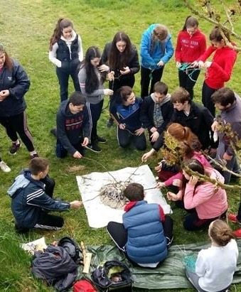
Venture Out Wilderness
Ireland
Outdoor Adventure Wellbeing Programs
EXPLORING
Barry DILLON, entrepreneur
https://www.venture-out.ie/
https://www.facebook.com/Ventureoutwildernessproject
https://www.instagram.com/ventureoutwp/
Introduction
Venture Out Wilderness is based in Galway and is a registered charity and social enterprise, not-for-profit, limited company.
They prescribe and deliver outdoor, nature-based therapeutic programs to people experiencing a range of diverse challenges in their lives. Through tailored personal development-focused programs, experienced Venture Out guides create opportunities for their participants to learn, grow, explore and enjoy the outdoors for their physical, social, emotional and mental well-being.
The Venture Out Vision
A socially-just, sustainable society, more integrated with nature and the outdoor environment.
The Venture Out Mission is to promote transformative outdoor learning experiences that enhance personal and interpersonal development, creating a deeper understanding of our interdependence on nature.

Slide 15
What Was the Trigger for Your Business or Entrepreneurial Idea?
We saw a need to combine outdoor, nature-based programs for people within marginalised and disadvantaged communities, in the promotion of their health and well-being.
The festival gathers a group of qualified social workers who wanted to provide experiential learning and personal development through the outdoors. The users could be a forest school group with early years, a teenage urban adventure club, or an extended wilderness-based personal development expedition. Whatever the need is for that specific group or individual, the organisers knew they needed to develop a bespoke program to suit their requirements. They knew they needed to develop something that was needs-led and needs-driven. They like to think of themselves as occupying the space between social care and the outdoors!
How Does The Business Help To Address Eco, Climate Change Or Sustainability Issues?
The first action that comes to mind is the Leave No Trace Principle.
The festival makes sure to eliminate plastic and reduce, reuse and recycle where possible when outdoors.
Leave No Trace is also incorporated into our education brief. It has a dedicated team of Leave No Trace trainers who deliver Leave No Trace education through our programs. For example, in the 8-week personal development program, a portion of that time will be focused on teaching young people about environmental protection and conservation, how long it takes food and rubbish to break down in the environment etc.

Slide 16
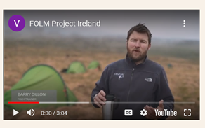
How are You Innovative in Eco-Health and Adventure? How Did You Start Your Business?
We are an innovative service because we predominantly work with youth work and family support-focused organisations to deliver programs to the people most in need at little or no cost to the participant. By adopting this inter-organisational & collaborative approach to our work, we find we can engage the people most in need of these types of programs, quite often those living at a disadvantage.
Myself and Nick met for the first time in 2015 on a Masters Course in NUIG, we quickly identified that we had the same vision and grá (Irish word for love) for the outdoors. We conceived the Venture Out social enterprise by coming together with the shared understanding that Ireland has not met the same heights as other countries regarding the potential of Outdoor Developmental Work. It is very much embedded in our neighbouring countries and utilised to great effect, changing individuals and whole communities. We believed we could replicate the same through our roles within the social care fields, we identified that outdoor programs were, broadly speaking, undervalued throughout the mainstream social service organisation and passionately believed that something needed to change. Venture Out became the platform to do this.

Slide 17

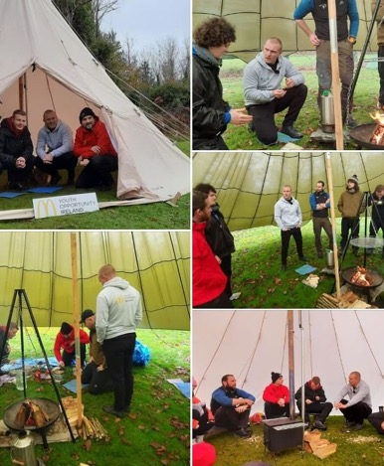
“
The experience has completely changed my perspective on where I thought my life was heading. It has given me a new perspective on things and confidence that I didn’t know I had.
Participant in recovery, 40yrs, completed our 7-day wilderness expedition program
“
How Successful Has It Been?
Having identified this gap, Nick and I knew ultimately that our company would be successful by designing and delivering outdoor developmental programs in a more inclusive, affordable and sustainable manner that could positively affect the lives of individuals and communities living at a disadvantage.
From this starting point, we knew we had to develop Venture Out Wilderness as a Charity, with an ambition to grow an organisation that gives the outdoors a voice among the myriad of mental health and well-being, and personal development-focused interventions that exist within social care professions. By establishing in such a manner, Venture Out provide interventions to the people and communities most in need, at little or no cost to the participants involved.
We have been very successful and have done all we intended to do particularly following our objectives and social enterprise impacts; promoting health and well-being across Ireland, among children, young people, families and whole communities.
This is achieved through a multitude of things; the provision of training programs, education, advocacy, and the design, development and delivery of a range of outdoor developmental programs. We have managed to fine-tune quality activities and programs that have been a success for all our users. We have recently updated by designing and delivering a range of outdoor-based personal development programs and interventions for our clients.
17

Slide 18

What Advice Do You Wish You Could Have Accessed When You Started?
I would say to make sure to get connected to the right people and networks. When you are a non-profit like us, governance is imperative, so we had to make sure we had a strong board in place, Get the right people with the right skills and experience in place. Get familiar with any funding and supports available. Without funding we simply couldn’t survive. A lot of funding applications take time and have strict deadlines so give yourself enough time to research and fill out the applications on time to ensure they are successful.
I would say to also get familiar with online and offline marketing, pitching to your target market and developing marketing campaigns and the brand from the beginning. We are still learning, and it has helped us immensely. Videos have been very useful in communicating our experiences, our website and social media ensure we get in front of our audiences.
What Were The Main Obstacles Or Barriers You Encountered?
One of our biggest obstacles is ensure we have enough funding. It is so important and key to our mission that our programs are accessible for our clients and are affordable.
We are not core funded. Our programs are complex they vary in price depending on the intervention we deliver, who we deliver it with and where they are delivered. Each program is designed specifically for the individual or group involved, so it is often difficult for us to give a generic price. It is therefore only possible to agree costs once we speak with each organisation directly to explore their needs and the options available. Where costs can be saved, we work closely with each organisation to ensure this happens. This could involve the pooling of resources, being creative around administrative and transportation costs, or it could involve submitting joint applications to fully or part finance the project costs involved. Either way, we tell the organisations and people we work with don’t be afraid, we are open to exploring all options with everyone!

Slide 19
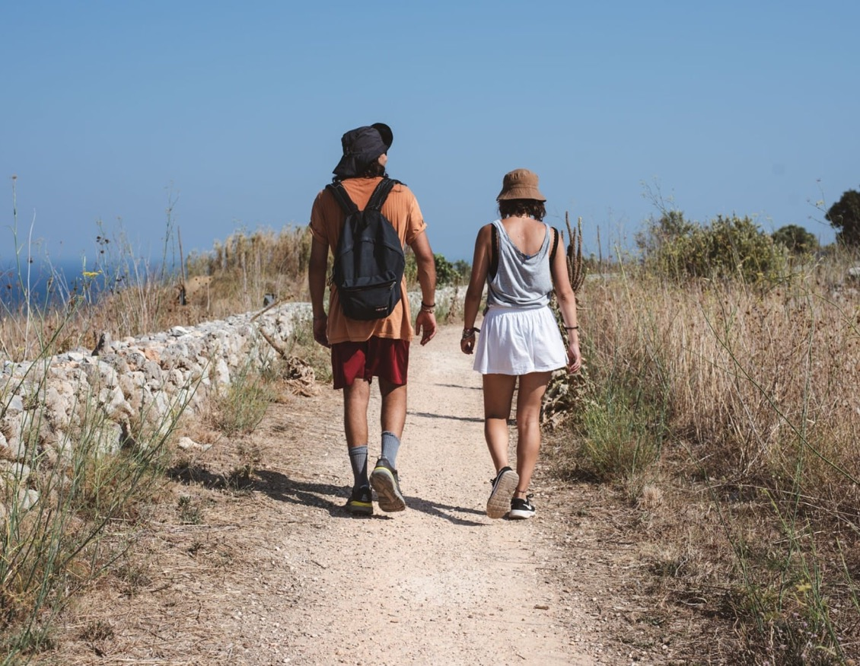

Lost in Nature
Outdoor Festival
Italy
Touristic and experiencing Festival
Glocal Tour Operator, Enterprise
STAYING FIT
Instagram
Facebook
PRESERVING NATURE
OUTDOOR SPORTS
LOCAL
FOOD
SOCIAL INCLUSION
ENVIRONMENTAL EDUCATION
Trekking
Yoga
Kayak
Rock-climbing
Kitesurf
Windsurf
Cycling
Foraging
Traditional
recipes
Healthy food
Sensitisation towards recycling
Responsible tourism
Nature knowledge
Some of the tours and activities were accessible to deaf and blind people
Location
Salento, a sub-region of Puglia, in South-Eastern Italy

Slide 20
What were the main stages in the creation of the Lost In Nature Outdoor Festival?
January 2019: IDEATION
Idea by Glocal Tour Operator to promote outdoor sports, design a new product, make more profit while promoting wellbeing, healthy lifestyle, sustainability, outdoor sports, deseasonalize tourism offer.
February 2019: DESIGN
Definition of: budget, team, roles, tasks, deadlines, milestones.
1st MILESTONE: the contract with the location owner was signed
March 2019: IMPLEMENTATION
2nd MILESTONE: official graphics and website with online booking platform. The festival was then advertised online and offline and people bought tickets.
After the event took place, there were post-festival thanks,
videos and pictures to keep the engagement with the public, who asks for a second edition. The planning process for the 2020 edition has started with new features, new designs and improvements.
How does the business help to address regional climate change or sustainability issues?
Lost in Nature Outdoor Festival Encourage walking and cycling instead of car trips and flying; or kayaking instead of boat trips.
It offers environmental education (teaching about endangered species, respectful attitudes when trekking, recycling, etc.)
It also offers deseasonalised experiences in a region where high season is the most preferred.

Slide 21
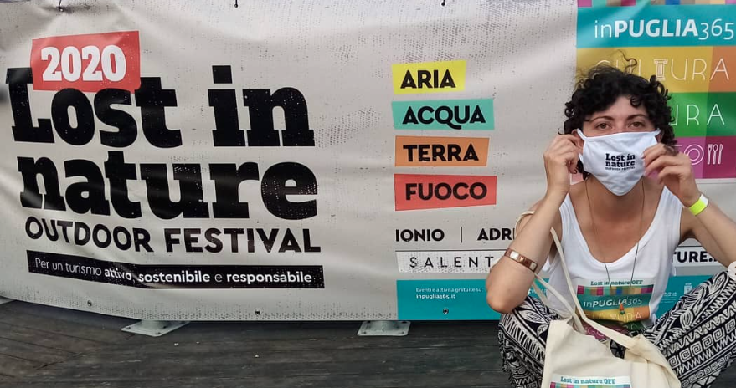
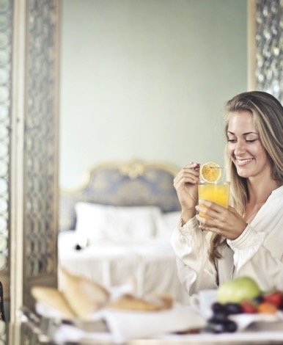
“
Lost in Nature Outdoor Festival | Instagram
Lost in Nature Outdoor Festival | Facebook
“
How is your product or service innovative? What gap in the marketplace does it fill?
What were the main obstacles or barriers you encountered?
During the 2019 edition, we realized that thorough terms and conditions and due diligence are a must to be shared beforehand, so we did for the 2020 edition.
Even though the festival is funded by Regional grants for tourism and culture, financial sustainability in the long term is difficult to plan we understood that regular experiences are a more successful format than a festival. A festival can happen as a coronation of a constant offer.
The festival offers regenerative tourism experiences, a familiar vibe and the feeling to be part of an 'outdoor' community taking care of sustainability.
Who are the stakeholders ?
Most are tourists and mainly young (75% are 24-35 yo). They are local people or proximity tourists in need for adventure, for the unknown, for authentic socializing, for well-being and many more.

Slide 22
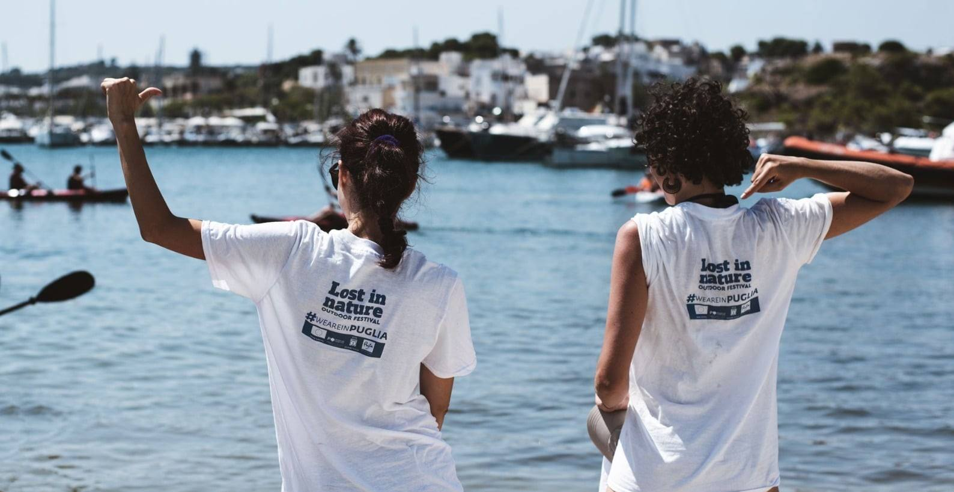
How successful has it been?
Sold Out Tickets
All tickets were easily sold out: 300 active participants + people who did not participate in the sports.
Local Businesses Benefited
Due to the number of participants, local restaurants, hotels, etc. benefited from the festival. They now want a second edition to duplicate their success during the festival.
Increased Customer Base
The founders and the organizers were able to expand their customer base because of the festival.
Good Return on Investment
The initial investment for the festival was about 6,000 euros, and the overall profit was about 8,800 euros.

Slide 23

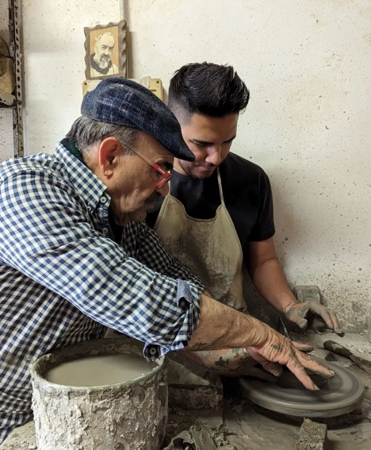
Wonder
Grottole
Italy
Reactivation of a rural village through food and other types of tourism
Netural Coop, Social Enterprise
www.wondergrottole.it/
www.instagram.com/wondergrottole/
https://www.facebook.com/WonderGrottole
CONNECTING
Introduction
Wonder Grottole is a social enterprise that works to revive the historic centre of the village of Grottole (30 km from Matera), through the regeneration of abandoned houses and the creation of a new community.
Wonder Grottole begins as an experimental project to engage and connect people and energies from all over the world. A visionary project that has captured the attention of Airbnb, and together, since January 2019, they have promoted the Italian Sabbatical project.
Location
Grottole, Basilicata Region, South Italy

Slide 24
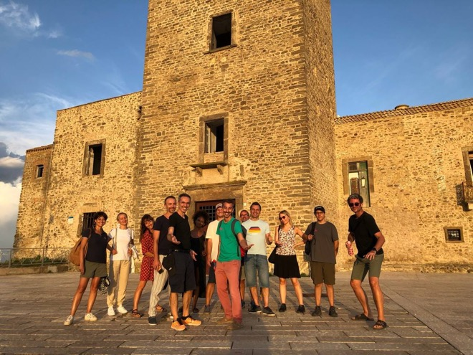
What was the trigger for your business or entrepreneurial idea?
Grottole is a small town with 2,100 inhabitants. It is located in Southern Italy in the region of Basilicata and it is 30 km from Matera.
However, its historic centre has only 300 inhabitants and has 629 abandoned houses.
During the last sixty years, its inhabitants have sought work in larger cities or abroad, giving rise to a rapid depopulation of the town, especially its historical centre.
According to a report by Legambiente in 2016, there are about 2,500 depopulated Italian rural villages, some semi-abandoned and other ghost towns.
How does the business help to address regional climate change or sustainability issues?
Grottole aims to experience the possibility of recovering the memories of this territory and repopulate the village of Grottole through the creation of a new community in harmony with the resident population.
What were the main obstacles or barriers you encountered?
The number of people visiting small villages is still too low to allow for financial sustainability, which does not provide sufficient visibility for the future.

Slide 25
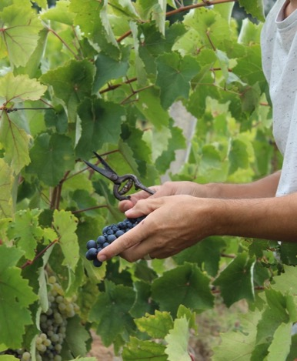
Where did you source the main support and resources?
The ideal tourist for Wonder Grottole is a tourist who no longer lives the territory passively, nor does he live by the simple experiences offered by the locals but becomes himself a protagonist because he brings and exchanges skills, values with the territory and his people.
How is your product or service innovative? What gap in the marketplace does it fill?
Wonder Grottole wants to experiment with a new tourism model, the 4.0 one, an evolution of the previous ones because it can systematize the recovery of the territory, favor an urban regeneration and create a new tourist market. The tourist no longer lives in the territory passively, nor does he live by the simple experiences offered by the locals but becomes a protagonist because he brings and exchanges skills, and values with the territory and his people.
The impact of this type of tourism is very positive as it increases the quality of life as well as encourages and generates new economies.
Wonder Grottole will connect existing human and resource capital with new people, new ways of doing things, looks and ideas to regenerate the old village and create opportunities. A wealth of culture, traditions and stories to learn about, use, tell and pass on.
There is a great heritage of culture, traditions and stories to know, tell and pass on and Wonder Grottole wants to preserve this collective memory.

Slide 26
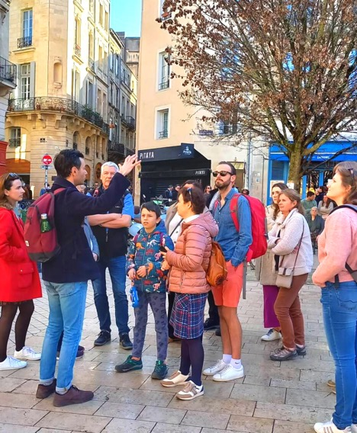

Vert Bordeaux
France
PRESERVING NATURE
Eco-friendly excursions
Emmanuel OTAYEK, entrepreneur
CONNECTING
https://vertbordeaux.fr/
https://www.facebook.com/agencevertbordeaux/
Instagram
Introduction
Vert Bordeaux is an eco-responsible excursion agency based in Bordeaux, founded in November 2021 by Emmanuel Otayek and Sarah Mark. We offer half-day and full-day excursions from Bordeaux to the Bay of Arcachon, Saint-Emilion and the Entre-Deux-Mers region.
Our aim is simple: to help you (re)discover the Gironde, its diversity and its complexity. There's no question of us spending a whole day tasting wine! What we want to do is give you an overview of each area we visit: old stones, local produce, natural areas, and meetings with craftsmen and producers… And of course, all of this is accompanied by convivial moments to share in a small group (8 people maximum) with your guide-driver Emmanuel. A real moment of well-being and reconnection with nature. Because there's something to suit all agendas, tastes and budgets, we also offer themed walking tours of Bordeaux, with a special focus on history and gastronomy!
To sum up, Vert Bordeaux it’s :
Original tours
In mini groups
3 different timings
Meetings
Eco-friendly

Slide 27
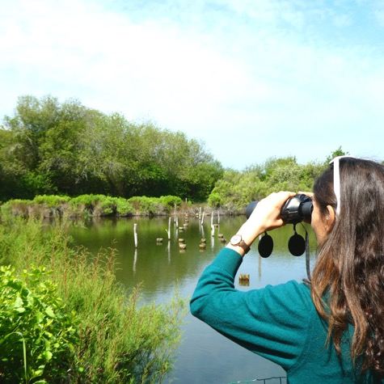
How was the project born?
Vert Bordeaux first came to our attention during a trip to South America, and more specifically during a minibus tour of northern Peru. We realised that we liked this way of exploring the countryside from a city and that it was very practical: no need to hire a car, time saved, explanations from the guide, meetings with other tourists, sharing and nothing to think about except enjoying! Back in France, we wanted to create an agency that looked like us to take visitors on excursions from Bordeaux.
Our project was quickly structured around two principles.
Firstly, to offer excursions that combine heritage, nature, gastronomy, crafts... in short, multi-themed excursions. And that's why? Because at Vert Bordeaux we love everything! Walks in the forest, climbing to the top of a medieval dungeon, tasting a speciality in the afternoon, sitting around a table with a good bottle of wine and sharing a moment with a local. Above all, we wanted to commit our company to an eco-responsible approach. We are already making efforts in our daily lives to consume less and better, so it seemed obvious to us that our excursions and visits, and more generally our way of working, should also be part of this approach like us.

Slide 28
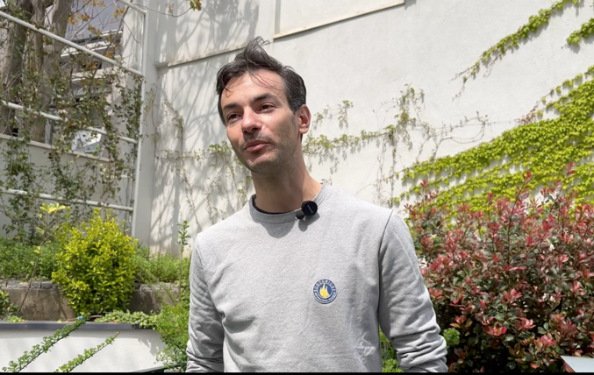
How does your project address climate issues?
Tourism is one of the most devastating activities for our planet today, so we must offer people concrete solutions for going on holiday in a virtuous way. We do our utmost to make our excursions and visits sustainable, both in the management of the company and in the content of our offers.
Our articles of association and our business plan are part of the Social and Solidarity Economy (SSE). We are committed to contributing to sustainable development and cultural promotion.
Our website is also eco-designed. Created by Clic Vert, it is lightweight and hosted on a server powered by green energy. It has a low carbon footprint.

Slide 29
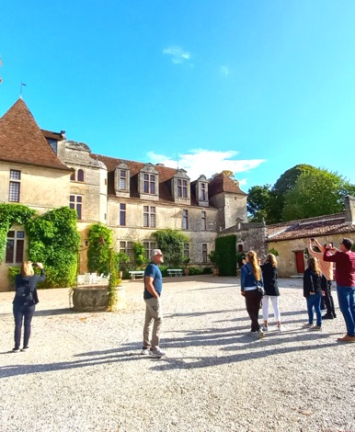
“
At Vert Bordeaux we don't "reconnect people with nature", we practice a pragmatic, everyday ecology, which we know can be improved but which we are convinced is well-founded.
“
Emmanuel Otayek
Founder and Owner of Vert Bordeaux
What are the strengths of your project?
We take great care in choosing our partners; the vineyards, for example, are committed to biodynamic farming, and the restaurants only work with local, seasonal produce. Local craftspeople are committed to respecting local know-how.
Also, internally, we have chosen a solidarity bank, NEF, the most ethical bank in France. Each year it publishes a list of the projects it finances and does not invest in carbon energy.
Our commitment stems from our day-to-day activities; we believe in what we do. A simple example: no single-use plastic in our towers or during our visits. We are very vigilant about the waste we produce.
Adaptability is a strong point, we are constantly creating new excursions, and we can improve and adapt our experiences over time, which is an asset for our business.
Finally, we take a global approach to tourism, aiming to combat mass tourism and spread tourist flows over the whole of New Aquitaine. There are so many things to see that it's important not to saturate tourist attractions!
29

Slide 30
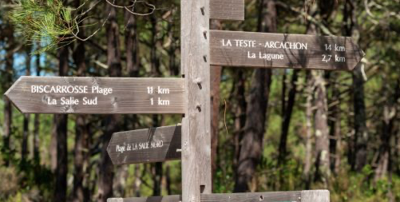
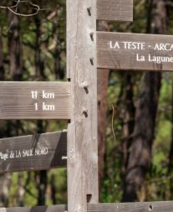
“
Chez Vert Bordeaux on ne “reconnecte pas les gens à la nature”, on pratique une écologie pragmatique et quotidienne, que l’on sait perfectible mais dont on est persuadé du bien fondé.
“
Emmanuel Otayek
Founder and Owner of Vert Bordeaux
What are your challenges for the future?
At the end of 2022, we decided to draw up a CSR (Corporate Social Responsibility) charter to list our commitments in full and explain our philosophy.
This document is a working communication tool that will be modified and enriched as our business evolves and develops.
You can consult this charter freely by clicking HERE.
Some of our upcoming challenges:
Creating a tour of Bordeaux focused solely on raising awareness of certain environmental issues.
We want to be transparent about the CO2 emissions produced by our diesel-powered vehicle. This gives an average of 24g/CO2/km per customer, which is equal to the emissions produced by a TER journey according to the SNCF. Next step: Adopt a carbon offsetting system with local players.
Adapt some of our existing products more to a French rather than an international audience.

Slide 31
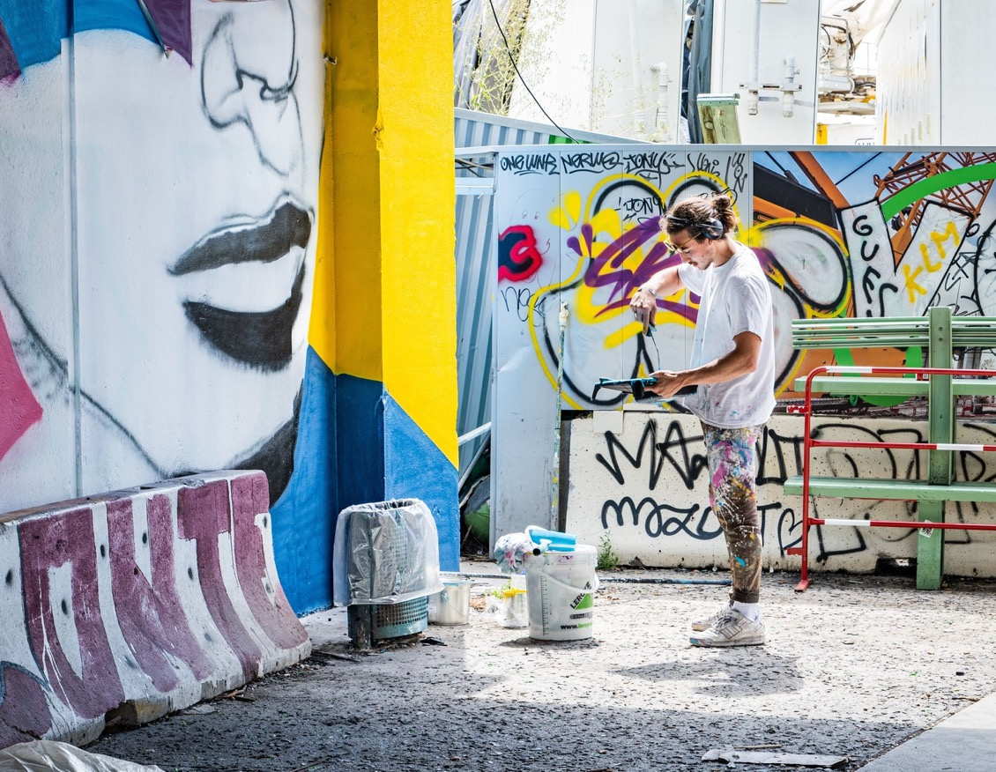
Street Art Avenue
Plaine Commune, France
Urban art trail along the
Saint-Denis Canal
Public administration services initiative
https://www.tourisme-plainecommune-paris.com/
https://www.instagram.com/streetartavenuegrandparis/
CONNECTING
What?
Where?
When?
How?
Urban art trail
Along Saint-Denis canal
Launched in 2016, available all year round
30 artworks to be discovered through sport, cruises, workshops and tours
The Street Art Avenue project aims on the one hand to create an artistic stroll along the Saint-Denis canal and on the other hand to promote the artists of the territory of Seine-Saint-Denis, French and European through street art.

Slide 32
How did the idea of setting up this project came about?
From the beginning of the 2000s, a policy of revaluation was born with the development of the banks, the creation of bike paths, and the staking of the Chemin de Compostelle ( ) ... The launch of Street Art Avenue® in 2016 is part of this dynamic. Today, despite the presence of raw and intense metropolitan equipment (highway, France football stadium), the places emit a very particular charm. The canal, like a blue thread, traces its way between a heterogeneous building: lock-keeper’s houses, industries, residences... The works of the Street Art Avenue® are integrated into this slightly offbeat universe, punctuating the post-industrial landscape with a few artistic interludes that create an urbanity.
How does the project help to address regional climate change or sustainability issues?
This project aims to create a new way of walking around the city for the inhabitants of the neighbourhood and tourists, by self-guided tours on foot or by bicycle. It also offers a sport route to invite people to move through street artwork.
Through tourism and a mediation program, this project allows the canal to get more visibility, supporting the territory’s cultural strategy.

Slide 33
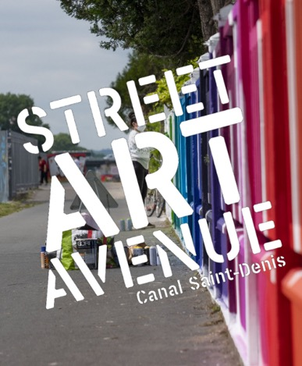
“
This project gives the canal an identity. I cycle along the canal on my way to work, and I pass artists in motion. I have changed my vision of the canal thanks to this project, which was a rather harsh landscape, with a lot of industrial wasteland.
“
Chiara Infantino,
In charge of patrimony and tourism at Plaine Commune
What were the main obstacles or barriers you encountered?
It is a question of promoting this place locally, frequented by many users, while ensuring an international anchoring, thanks to both a world scene and a local, emerging scene. This is the ambition of the artistic direction: to write a story that allows for an original positioning for this route.
Also, the multi-partnership framework requires work because decisions are the result of a collegial reflection
Where did you source the main support and resources
(eg grants and other support)?
The project is funded by local public bodies: Aubervilliers, Saint-Denis and Paris cities but also the department of Seine-Saint-Denis. For example, The towns through which the canal passes can finance solidarity cruises for people from the social field.
The Intercommunal Tourism Office offers many ways to discover the Street Art Avenue: lots are free but some are charged as cruises, creative workshops and guided tours. Tailor-made proposals can be made for groups.

Slide 34
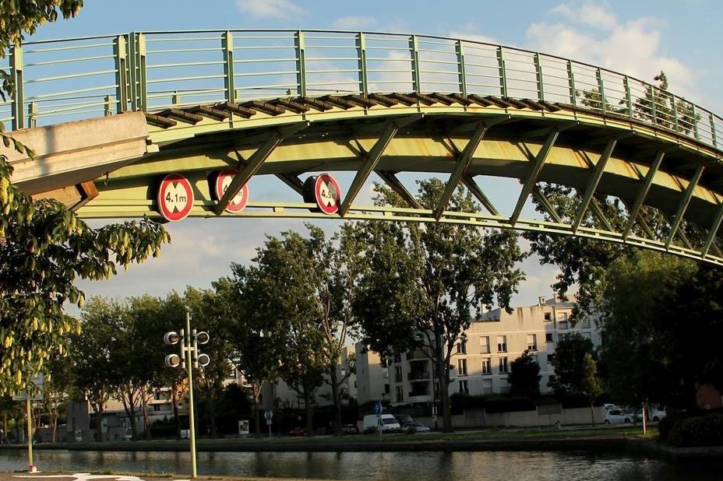
How successful is the Street Art Avenue project?
In 2022, the review was positive:
81 cruises with 5048 passengers
10 tours for a total of 20 hours of visits
10 artistic practice courses led by 3 artists and around 40 beneficiaries
For the next years,
Street Art Avenue aims to increase social inclusion through a resident participative process.
Consideration is being given to the development of the project during the period of the Olympic Games in 2024 to improve the sportive dimension.

Slide 35
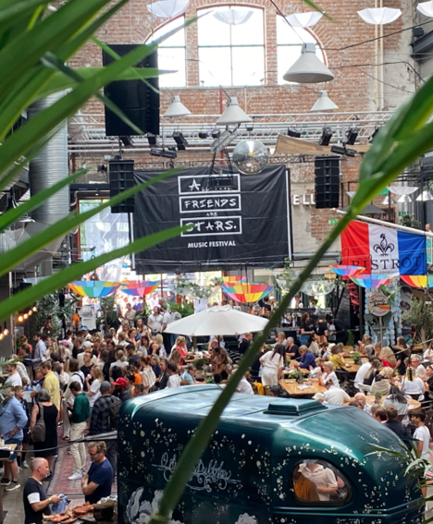
All my Friends are stars
Gothenburg; Stockholm; Visby; Norrköping, Sweden
Festival
https://www.allmyfriendsarestars.com/
https://www.facebook.com/allmyfriendsarestars/
https://www.instagram.com/allmyfriendsarestars/
CONNECTING
Introduction
In 2016 the festival started in Gothenburg by founders Americk Lewis and Nicholas Sosin as a small gathering of friends sharing live music under a bridge. The two festival founders, originally from New York City, didn't know of the Swedish Jantelagen culture, a mentality that encourages people to not stand out too much. Therefore, with a passion to unite people and a desire to showcase the amazing local talent, the festival concept was born, creating a platform for people to shine and believe in themselves.
The festival focuses on diversity, featuring a mixture of artists, fusing visitors of different ethnicities, cultures and ages.

Slide 36
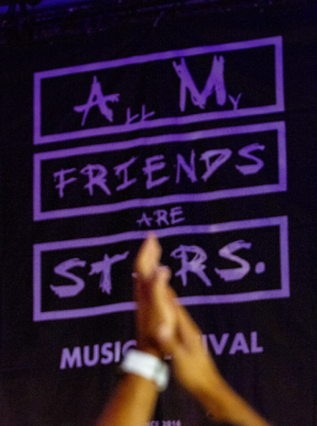
Who are the stakeholders of this initiative?
The main stakeholders are young people, mostly with immigrant backgrounds (but not only) not having access to promoting their music. The festival promotes that everyone can be a professional musician.
Also, the audience is very diverse because the festival aims to keep affordable tickets, to encourage diversity among those attending.
What is your business model?
The business model is using the format of a festival as a platform for promoting young people (without resources) and their music. The format was informal at the beginning but it started to join forces/collaborate with other festivals such as street food festivals (Lindholmen) and so on. Free of charge for the performers, affordable ticket prices encourage diversity among those attending. Now it’s becoming established.

Slide 37
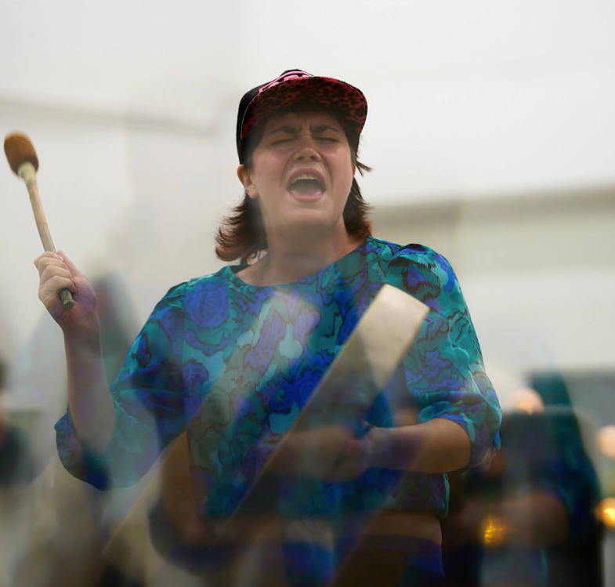
Why is it a good practice?
The festival is family-friendly to create an overall great experience for the audience and there’s always great food and drinks during the festival. The entrance fee is kept at a low cost so as many people can attend as possible, no matter their background or social status, all are welcome to come and enjoy great live music.
In 2023 the festival will take place for the eighth year in a row and present over 70 different artists and performances, over nine events in seven different cities across Sweden.
Mixing local talent with international ones, the festival creates a unique mix of artist genres and cultures and countless opportunities for new artists to develop their careers.

Slide 38
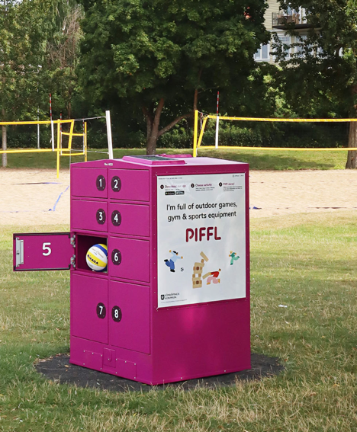
PIFFL
Gothenburg, Sweden
Sharing platform for sport and outdoor games
Enterprise
STAYING FIT
https://www.piffle.se/
https://www.facebook.com/pifflboxh
ttps://www.instagram.com/pifflboxes/
Introduction
PIFFL was created by two entrepreneurs having the idea a problem of their own: not always having sports equipment available when in need. The project was born from their common interest in making it easier for people to do spontaneous sporting or gaming in green areas and parks.
PIFFL inspires sharing economies where we can reduce disposable consumption and create prospering and sustainable cities together.
PIFFL offers a platform for, among others, cities where they can make sports equipment and leisure games available in areas where people spend time. The platform consists of boxes that can be unlocked via a mobile app. It is offered as a service where a city pay for the boxes and the user pay just a small fee for accessing the content of the box.
A possible next value is the user data that is collected. Gives customers, and cities, new insights into how parks and green areas are used.

Slide 39





“
Increased accessibility drives healthier societies
“
Instead of 5000 inhabitants owning a volleyball each around the local public volleyball court, one single volleyball could be shared by everyone.
Core concept
The Piffl box is filled with several activities to meet different needs and interests.
Wide rang of activities
Activities where
you are
Piffl enables activity and sport in the local environment for everyone, no matter if you are a resident or a visitor.
Piffl inspires sharing economies where we can reduce disposable consumption and create prospering and sustainable cities together.
Inspire Sharing
Democratized access to activities and sports equipment gives all people access to active leisure time regardless of prerequisites.
Easier access

Slide 40
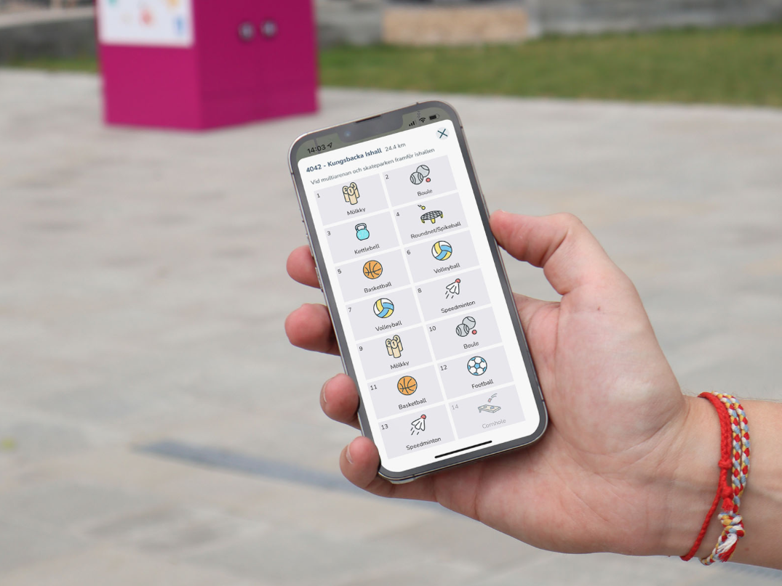
Why is it a good practice?
PIFFL allows users to buy fewer sports or leisure equipment, encouraging sharing and sustainability of the products that may stay on a shelf most of the time.
People can use parks or green areas more actively, having a positive impact on their health.
In addition, this concept is replicable by cities or housing companies, by offering this kind of boxes in their parks or green areas.

Slide 41
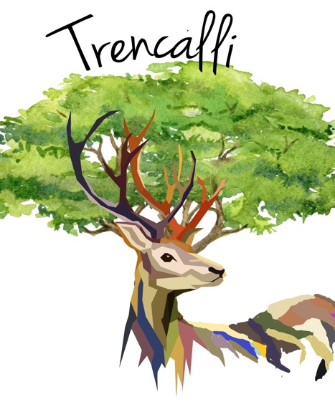
Ferme Trencalli
Castelnau Rivière Basse, France
Nature Farm
Morgane and Stéphane VITSE, entrepreneurs
http://www.trencalli.fr/acces.htm
https://www.facebook.com/lescabanesdetrencalli
CONNECTING
Introduction
Twenty years ago, Morgane and Stéphane decided to completely change their lives and immerse themselves in nature. They moved to the Hautes-Pyrénées to pursue their shared passion for horses and open an equestrian lodge, taking advantage of the surrounding environment with adapted hiking trails. Stéphane left his job as a financial manager to become a farmer after undergoing training. They started their farm with dairy cows and deer and began developing agritourism alongside their production. This tourist activity was designed to be eco-friendly and family-oriented from the beginning, with eco-friendly lodgings such as floating cabins, treehouses, and « Hobbit » habitats built with local materials. This project was later expanded to include a farm school that welcomes students and school groups, allowing them to raise awareness about environmental protection. The development of the Trencalli Farm around these virtuous practices now allows them to hire 2 to 3 employees during the high season.

Slide 42
How did the idea of setting up this project came about?
For Stéphane, ecotourism is above all a way of life and of combining his professional and agricultural activity with the protection of the environment. This project is also a matter of improving and protecting the surrounding ecosystem by local tree species, creating water points, or using organic farming techniques. It is a philosophy of life, a different path from the consumer society that allows us to meet needs and reconnect with others, nature, and animals. The key is to create a reasoned project on a human scale in the heart of a territory and to adapt one's activity to a more sober and respectful way of life. Ultimately, Stéphane and Morgane hope to be able to accommodate a maximum of 40 people within the Farm.
What is your business model?
Despite Stéphane's knowledge of business management, the couple faced some difficulties, especially during their installation, where they had to be combative to convince the administration and banks of their project. This quality and persuasive strength allowed them to prove that it was possible to do things differently.
Afterwards, Stéphane and Morgane gained experience over time and through many exchanges and sharing with other farmers, including joining a network of educational farms, "l'échappée verte", or by continuing to learn throughout the project. This experience was also gained through their mistakes which they were able to correct over time, and from which they were able to bounce back, as they were well supported in their project!

Slide 43
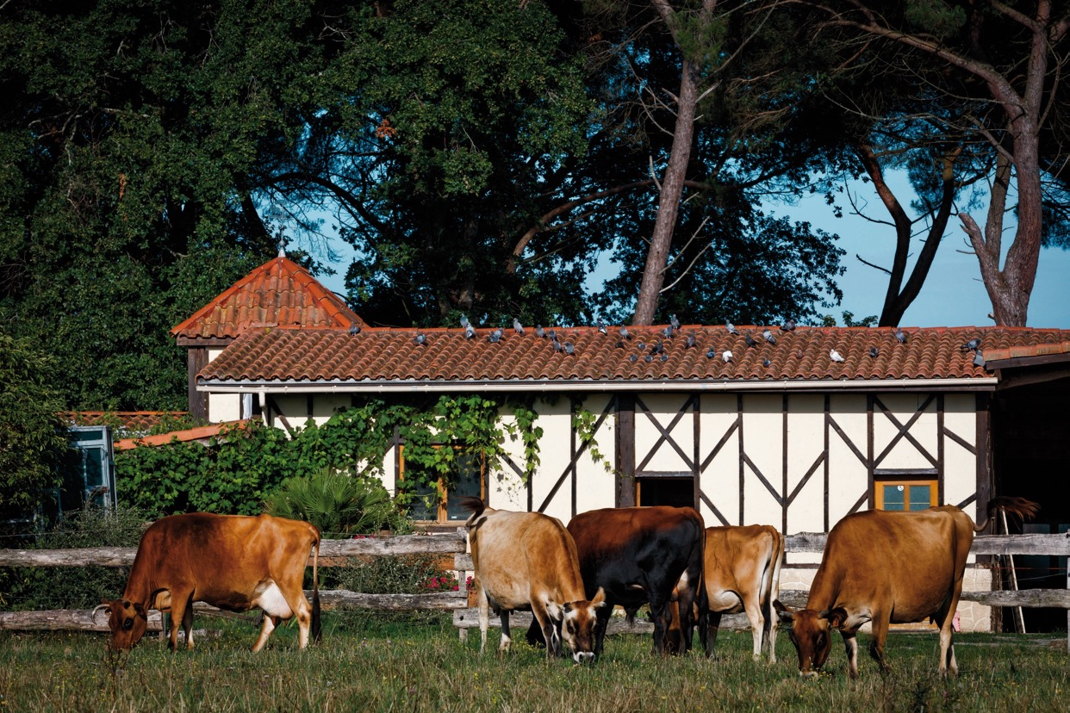
“
Lost in Nature Outdoor Festival | Instagram
Lost in Nature Outdoor Festival | Facebook
“
Any advice based on your experience for those who want to start their own business?
For Stéphane, it is important to develop one's project while gaining more experiences and allowing oneself to dream while remaining realistic, because an ecotourism project is not just a good idea, it also requires acquiring knowledge in business management to ensure its sustainability. If one is well supported and their project has matured, they should not hesitate to leap!

Slide 44
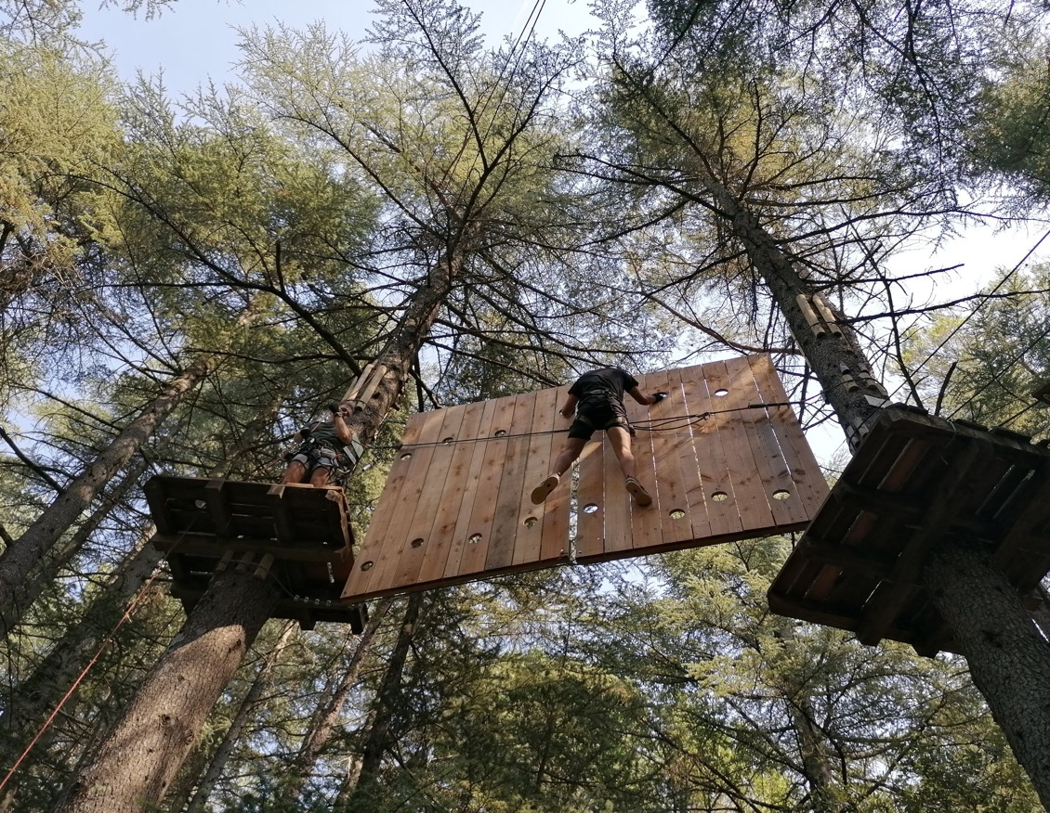
STAYING FIT
L’Aoubré
PRESERVING NATURE
Flassans sur Issole, France
Forest leisure park
Rémy ROSEAU, entrepreneur
https://aoubre.fr
https://www.facebook.com/aoubreaventurenature
What?
Where?
When?
Which activities?
30 hectares of nature park
Var, South-East of France
Launched in 2020, open all year round on week-end and holidays
tree climbing, a butterflies garden, a farm and more!
Twenty years ago, Rémy Roseau, who was fortunate enough to own a family plot of land with abundant vegetation, had the idea of creating a forest leisure park there, to introduce families to this environment through leisure activities.

Slide 45
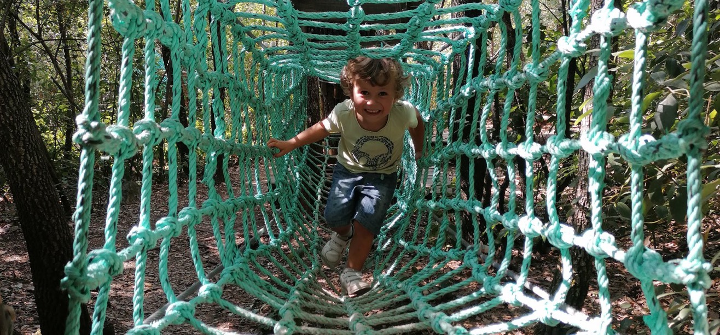
“
Lost in Nature Outdoor Festival | Instagram
Lost in Nature Outdoor Festival | Facebook
“
What was the trigger to start this business?
His goal was to help visitors understand how an ecosystem works and why it's so important to protect it. While he had always been environmentally conscious due to his upbringing in a rural area and his studies in agronomy with a focus on ecology, it wasn't until he turned 50 that he realized it was the right time to make this project a reality, one that he had already envisioned for a long time.
For Rémy Roseau, ecotourism is the concept of bringing people to an environment to engage in low-carbon impact activities that are not just mere distractions, but that also appeal to their intelligence and sensitivity. Through ecotourism, the aim is to introduce visitors to a social and environmental setting, encourage them to understand it, and ultimately inspire them to preserve it.

Slide 46
Why is it a good practice?
Rémy is committed to ensuring that each experience is unique to every individual. He believes that a project is linked to a socioeconomic context, a piece of land, a person, and their history. Rémy's experience was shaped not only by his life journey but also by his travels and the successes he observed in others, which allowed him to stand out and continuously improve his project. While the economic aspect is often underestimated, it greatly influenced Rémy's project, especially when he created his Butterfly Farm. He had to be persistent and resilient in the face of administrative and technical difficulties. He also had to learn how to manage his activities and embrace the role of a business leader while collaborating with his employees. His naturally positive mindset helped him to overcome difficulties and keep moving forward, one obstacle at a time. Other qualities such are curiosity and agility are also necessary for his view for undertaking such a project.
Any advice based on your experience for those who want to start their own business?
Entrepreneurship requires being well-equipped, both in terms of project planning and finances. Other paths to enter the ecotourism industry are also possible, such as working for existing structures to allow
time to mature your project and the message you want to convey. Whether as an entrepreneur or an employee in the ecotourism industry, it remains a great opportunity to participate in the ecological transition and to help people step out of their urban reality. For Rémy, the most important thing is to keep an open mind and eyes to move forward.

Slide 47
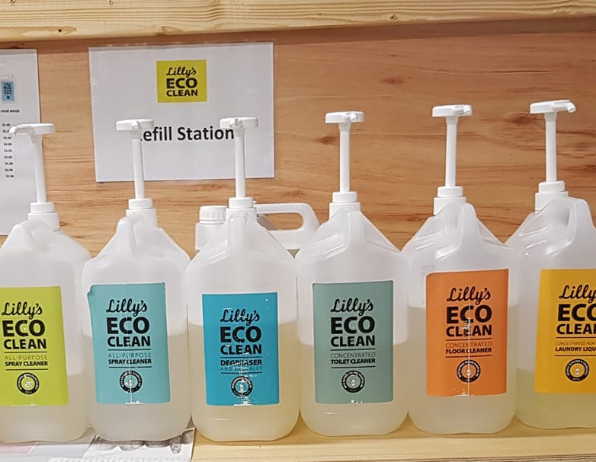
PRESERVING NATURE
All Things Natural
Sligo, Ireland
Zero Waste Refill Shop
Edel BURKE, entrepreneur
https://allthingsnatural.ie
https://www.facebook.com/allthingsnaturalnorthwest
What?
Where?
When?
How?
Zero Waste Refill Shop
Market Cross,
Sligo Town
Launched in 2020
Eco Store with non-packaged products
The Street Art Avenue project aims on the one hand to create an artistic stroll along the Saint-Denis canal and on the other hand to promote the artists of the territory of Seine-Saint-Denis, French and European through street art.

Slide 48
What is the business model?
Edel runs the business on her own. With no other shops in the town for people to refill their products, it can get very busy. So, capacity is a challenge. Another challenge is branding and marketing. The customer base is built on reputation and local knowledge. Edel tries her best to keep her social media channels up-to-date, a like and a share is huge for her small business.
The business model is based on the idea of recycling and reusing and supporting local businesses.
Start small – come in with an old bottle/container, fill it up, (which is much cheaper) and see how you feel.
Seek out locally-made products.
Give a like and share for small businesses in your community – without these little businesses, towns are gone!
Who are the stakeholders?
All Things Natural is on a mission to be a leader in the development of circular economy products and to support local businesses. They want to work with people and communities to make green living more accessible and collaborative…we’re all in this together. One small change from each person can make a difference.

Slide 49
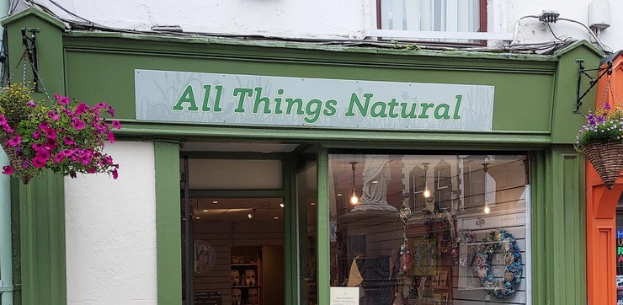
“
Lost in Nature Outdoor Festival | Instagram
Lost in Nature Outdoor Festival | Facebook
“
Why is it a good practice?
Economic
Edel engages in a business model that challenges people to think and behave differently in their consumer choices. The advantage is better consumer behaviour in drawing attention to throwaway culture and replacing it with a more thoughtful approach to shopping and an awareness of where your products are coming from. This circular economy approach is very beneficial to local businesses and also in circulating revenue within the economy.
Social
The social impact of this business model cannot be underestimated. Awareness building of new approaches to shopping and behaving in more earth-friendly ways within a local community positively impacts the community and to pay attention to the impact of their choices. It builds communities and creates more connections on how one small change can make a big impact.
Environmental
The environmental impact positively affects the community by reducing the amount of waste and plastic in circulation. It also allows people to consciously choose what they need without overbuying. It reduces the amount of waste and packaging that consumers need to bin.

Slide 50
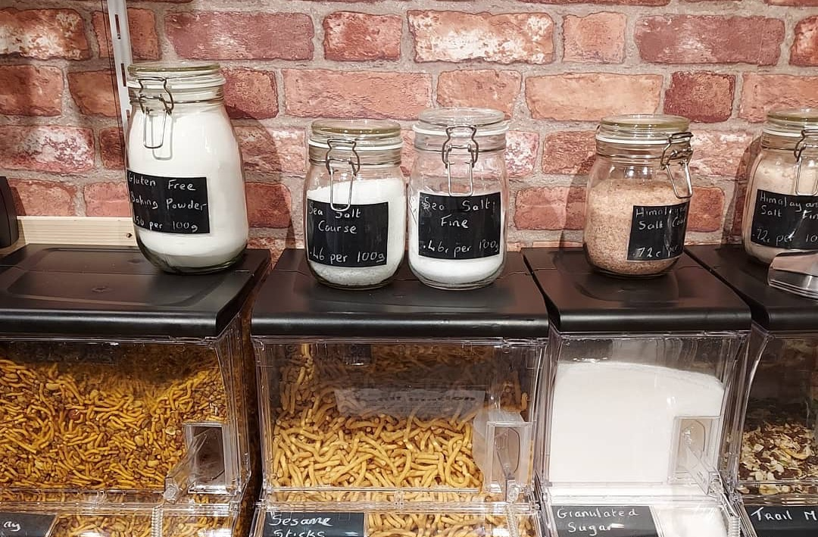
What were the barriers, and do you have any advice to teaching entrepreneurship?
Barriers
Resources - Access to the right people.
Time constraints. Entrepreneurs are in the mode of doing. Time is limited.
Resistance from trainers- Formulaic approach to teaching. Might not involve relevant stakeholders to consult on program design. Outdated information.
Assessment challenges- How do you test knowledge on this?
Cost implications
Value creation
Advice
Plan (Business plan, market research, SWOT, PESTLE)
Be prepared to fail.
Resilience
Do your research.

Slide 51
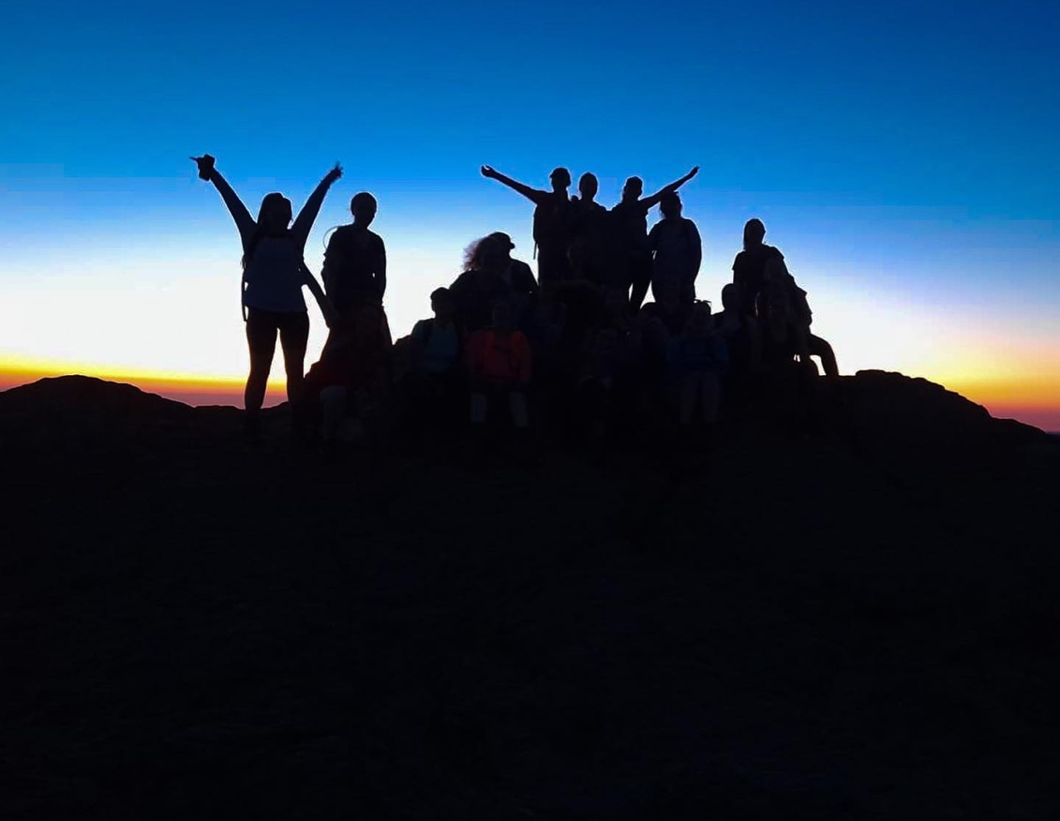
Galz Gone Wild
Ireland
Hiking community for women
STAYING FIT
Melissa McDERMOTT, Entrepreneur
https://galzgonewild.com/ https://www.instagram.com/galzgonewild_ https://www.facebook.com/galzgonewild/
EXPLORING
What?
Where?
When?
How?
A women community to explore the world
Through the world
Since 2017
Offering women-only tours
Melissa started Galz Gone Wild because she couldn’t find outdoor hiking clubs that were not male-dominated. She wanted to explore her connection to nature, to other people and with herself and was not able to do that on these hikes. She wanted to create a community of women who went hiking. So, off Melissa set on a training path to undertake mountain skills training and first-aid training, posted a Facebook event and voila.

Slide 52
“
It was pretty clear to me that day that there was a need for women to come together and connect with each other and the outdoors
“
Who are the stakeholders?
Women from all walks of life. GGW welcome Our Black, Indigenous, BIPOC, Lesbian, Bi Sexual, Trans, Women with Disabilities, Women in Recovery and Women of size. We strive to nurture self-love, increase confidence, explore creativity, practice mindfulness but most importantly, to have fun and forge lifelong friendships both on and off the trail.
What are their problems and needs?
Problems
Loneliness
Low self-confidence and self-worth
Find a new skill
Stress
Anxiety
Depression
Exercise
Weight
Needs
To connect
To explore
To practice mindfulness
To meet new people
To have fun
Get creative
To exercise

Slide 53

What kind of solutions were implemented to solve these problems?
Women will have their reasons for joining the GGW community. There may be an expectation of fulfilment, contentment and joy in meeting new people, exploring new landscapes, connecting with nature and seeing the interconnectedness of body, mind and soul.
The main problem identified is that there were plenty of hiking groups in Ireland however, there were none that were cognizant of the specific needs of women.
Melissa identified a gap in building a business around hosting weekly hikes for women which includes building a community of women who feel empowered and listened to and where they have created an experience of a lifetime in the outdoors, nurturing relationships with themselves, fostering new relationships and connecting with nature. The benefits of nature are well documented in lowering blood pressure, and providing a sense of calm, slowing down the mind to the stillness and wildness of nature.
What is the business model of GGW?
Melissa employs a sustainable business model allowing access for all women to join in. Pricing includes initiatives like pay it Forward, subsidized rates for students, the unemployed and those on low wages.
Melissa also has a Peak membership model in place that allows access to our ‘Peak Member Only’ events e.g. Talks, Swap Shop Parties, Movie nights, Rise and Salt sea swims and more, first to sign up for our Hikes, Getaways, Workshops and Challenges as they hit the website, discounts off GGW Webinars
There is a price point attached to each event.

Slide 54
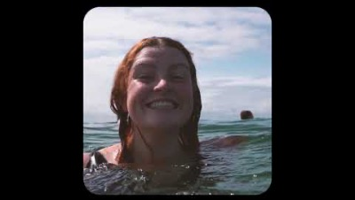
Why is it a good practice?
Galz Gone Wild is an example of good practice as it addresses some of the key points in Eco Health Tourism. Melissa addresses sustainability in the following ways:
Economic
The GGW community embraces all women and allows access to hard-to-reach groups by using pay-it-forward initiatives. The spin-off effect of women travelling to hike meetups, overnight stays, food, coffees and supporting local businesses has a ripple effect. Mel’s business model is not about amassing huge profits but by maximizing the potential of the outdoors and cultivating friendships and peer networks for women. No doubt some of these hikes spur other businesses’ innovative ideas.
Social
The social impact provides the greatest measure of good practice. Increased self-confidence, meeting new people, forming new friendships, learning new skills, and empowering women with tools to deal with adversity, stress and anxiety.
Environmental
Melissa is a strong advocate of leaving no trace. Melissa caps her hikes at 10 to ensure that the landscape is minded and respected while traversing the peaks and valleys of the mountains.

Slide 55
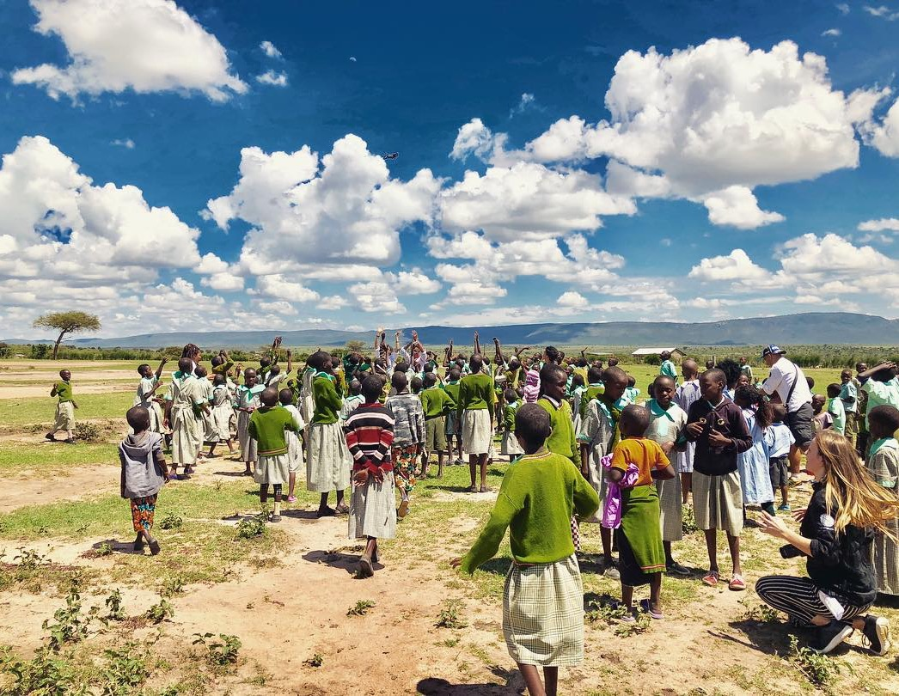
Move for The World
CONNECTING
Brussels, Belgium
Youth program
Melissa McDERMOTT, Entrepreneur
https://www.facebook.com/MOVEFORTHEWORLD/?locale=fr_FR
What?
Goal?
How?
For who?
A preventing and combating system against school failure and dropout
to enable disadvantaged youth to embark on an international mission
by creating spaces for inclusion, strengthening social cohesion and building together
Boys and girls aged 16 to 24
Since its initiation, the MOVE for THE WORLD project aims to mobilize young people in a situation of the school and social dropouts as well as invisible youth to prepare and activate them in an especially inspiring mission of discovery, inclusion, empowerment and cooperation around the protection of the environment, eco-tourism, the fight against climate change and the promotion of local cultures and crafts in an inspiring destination all over the world, in USA, Tanzania, Zanzibar, China, Palestine, Tunisia. Missions to France and India are under preparation.

Slide 56
How does it work?
Each mission of around 30 youths is following 3 phases over a period of 12 to 18 months:
The mobilization and preparation of the mission, made with the direct involvement of youths reconciling the different objectives of the discovery of inspiring and unique spaces with all the related logistics, the identification of local stakeholders and inspiring personalities as well as young people, and the discovery of the problems relating to the protection of the environment
The mission: an exceptional trip to a deeply inspiring destination to meet other young people with a development cooperation activities to undertake
The orientation: At the end of their course, young people are expected to return to school, or else go into vocational training, seek employment, or even set up an entrepreneurial project.
Who are the stakeholders?
Initiated in 2013, MOVE for THE WORLD aims to develop a dynamic between young people from underprivileged backgrounds in Brussels Capital (essentially from municipalities around Molenbeek) who are failing at school or dropping out including invisible youth, 60% of whom are girls and 40% of boys between the ages of 14 and 24, of all ethnic origins and all religions (80% of them come from immigrant backgrounds).
        These young people are in a difficult socio-economic situation, and they come from families living for most of them below the poverty line. They were often confronted with situations of social violence.
        The groups generally mobilized for missions are from more than 10 nationalities (Maroc, Irak, Tanzania, Portugal, Brazil, Italy, Poland, Spain, DRC, Senegal, Algeria, Romania, Belgium, …).

Slide 57
What is the strategy adopted?
The strategy that is adopted and which directly participates in the DNA of the Organization for more than 10 years with results of more than 90% success meets the following general principles:
The young person is selected within the framework of a screening relating to his motivations, aspirations, potential capacities, family and social situation;
The young person is accompanied over time (from 12 to 18 months if not more) throughout an evolutionary course;
The organization establishes a contractual relationship with each beneficiary in which the young person commits to exemplary behaviour (0 incivilities, 0 absenteeism) otherwise at the risk of being excluded from the program;
The system set up around the young person and for his benefit combines a collective and multicultural dynamic with a specific course of individualized support and tailor-made accompaniment;
The system put in place articulates and combines capacity building and learning actions (upgrading, languages, environment issues, ecotourism, etc.);
The young person's journey includes production and/or participation in a creative project (audiovisual or scenic production, construction or participation in a cultural or civic event, etc.);
The course aims to develop a project for the future and life around a formative project of learning and/or activity, personal development or entrepreneurship;
The organization includes in the course of the young people the adapted intervention of many Belgian partners (such as ACTIRIS, Bruxelles Formation, the Cité des Métiers, …) or European associations, private companies
The promise of a rewarding international exceptional mission and/or an internship on the other side of the world to exciting destinations;
The young person is accompanied by qualified and experienced workers;
The system put in place benefits from a synergy effect with the other activities of the organization such as the University of Families which works to upgrade and strengthen teaching (mastery of languages, basic skills) coupled with a personal development program;
Young participants are valued to have a direct impact on their young entourage as inspiring role models. A communication strategy by young people for young people is developed throughout the course.
These principles of project intervention directly impact the beneficiaries since they directly inspire the capacity-building activities of young people and are implemented throughout the course offered and the system of his support.

Slide 58
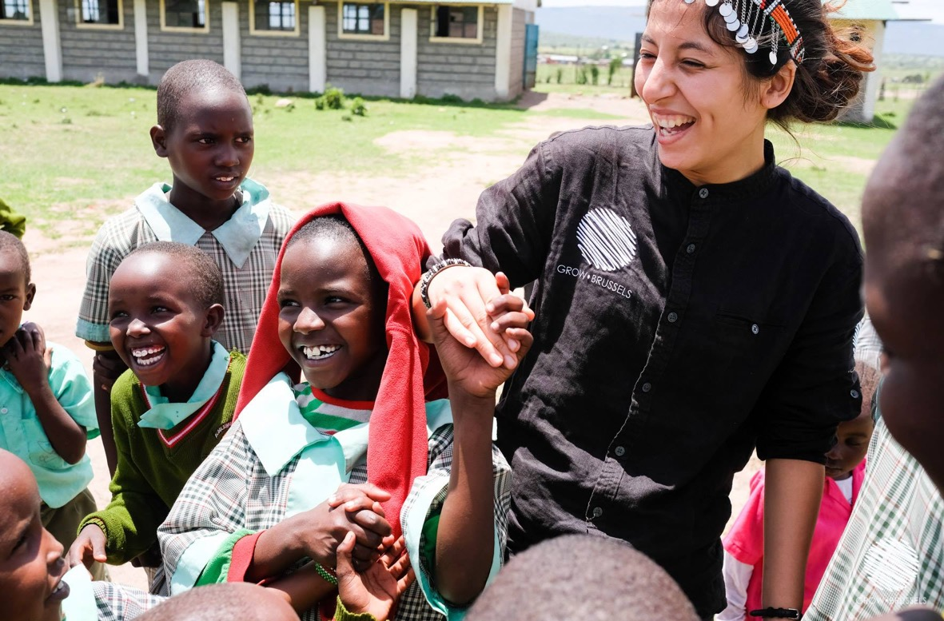
Why is it a good practice?
The project's strategy is to promote the inclusion and activation of young people in new professions likely to interest them greatly and to motivate and to mobilize them at the same time for a very rewarding action to safeguard and strengthen the sustainability of their environment and of the territory. Such an approach is strong because, on the one hand, it activates the young persons about a territory from which they have often thought that they are excluded or from which they wanted to exclude themselves and, on the other hand, it makes the young persons responsible for a question and on issues that are important if not crucial for the « humanity ».

Slide 59
The general principles are as follows:
The support method places the young person at the heart of a circle of synergies carried by all the actors concerned: the organization, the educational and social actors and the partner institutions which will be mobilized according to the needs which will have been identified. It is a question of federating and communicating on an ongoing basis with all the actors concerned by the young people;
The integration of the project within a supportive and complementary dynamic that enriches the path of the young person with the activities already undertaken by the organization and the possible involvement of the young person in these activities: "a star, a Destiny”, the University of Families, the Academy of Parents, Canal Oxygen, University Jury Central…
By including parents, when possible, in the system, considering the principle of parental responsibility. The function of a parent is universal, and it seems important that women and men work together to acquire tools aimed at the development and success of their child(ren), whatever their( s) age(s).
Through the combination of complementary and synergistic activities of training, animation, personal development, orientation and creation which are generally not combined. The project works with a constructive and unifying transversal approach;
Through the identification and implementation of a specific individualized course adapted to the young person and his aspirations and his abilities as well as his social and family realities;
In addition to collaborations with social, educational and psycho-medical actors, the organization develops collaborations with actors from the economic and cultural worlds who are mobilized and involved as needed;
Through openness to the world with the preparation and organization of an exceptional journey of discovery that places the young person in a new perspective likely to open their eyes beyond their microcosm and problems.
Through the continuous integration of communication actions with the actions undertaken on the social networks of young people on their activities, or simply on clip and film projects that they produce as part of their activities via the social media of youth. This approach, in addition to “valuing” young people at certain times in their careers or certain of their activities, also constitutes a formidable lever for multiplying the impact of social media generally generating several hundred thousand views. The young person becomes an actor and/or author of his destiny.

Slide 60
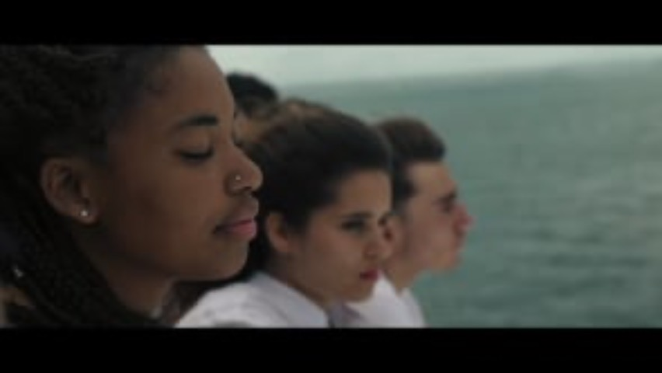
What are the common barriers to teaching entrepreneurship in inclusive tourism?
The main barrier is the lack of knowledge of the actual environmental issues in general and of ecotourism in particular. If everyone has a vague perception of environmental issues and the climate challenge, ecotourism as an obvious and logical response to these issues is not yet perceived as a new essential approach to discovering and acting for the planet. Young people do not perceive yet clearly the immense diversity of professions and activities that this new approach to tourism introduces.
The education system in general, as well as professional education in tourism, has not yet integrated the paradigm shifts that environmental issues require to be considered. It is not a question of giving an additional course on environmental issues, but of reviewing the whole approach to tourism, travel and the discovery of the world.
SEE MORE

Slide 61
“
The original idea was to offer young people from disadvantaged backgrounds and school drop-outs an exceptional and inspiring trip that would enable them to discover the world and other people, as well as themselves. Participation in the trip was soon made conditional on the young people respecting a code of good conduct and success. This is how exceptional discovery missions were organised in the USA, China, Tanzania, Zanzibar, etc.
“
Olivier Donnet
To find out more, read the interview with Olivier Donnet, Project Manager:
Could you give us a brief overview of the development of MOVE for THE WORLD programme?
Gradually, this "trip" has also been enriched by a cooperation or assistance mission, such as restoring or fitting out a classroom in a school in the bush in Tanzania or leading a group of children in an orphanage in Zanzibar. Over the years, the scheme has become increasingly structured, and the trip has become the visible face of a programme to activate and strengthen the capacities of young people over a period of 6 to 18 months. The young people are involved in its preparation through regular meetings and training sessions that provide individual support for each young person on the programme and generate a constructive group dynamic.
Finally, in recent years, and especially since the end of the COVID restrictions, the scheme has been further enriched by focusing even more decisively on environmental protection, the fight against climate change and the discovery of ecotourism - themes that are particularly inspiring and interesting for young people - and by also involving young people from the countries visited, as was recently the case in the pilot missions organised in April and May in Tunisia.

Slide 62
What makes MOVE for THE WORLD different from organising a nice "trip" for young people from disadvantaged neighbourhoods, as many associations and even some local authorities do?
Travelling for young people, particularly those from disadvantaged backgrounds, and discovering the world are always enriching and exciting, and there can never be enough initiatives to enable young people to discover and open up to the world.
What sets MOVE for THE WORLD apart is multiple. On the one hand, it's the pathway offered to young people before and after the trip. The trip is just the visible facet of a journey that takes place over time. It's a journey of preparation for the mission and capacity-building for the young people, particularly in terms of their ability to express themselves, languages, etc. It's also a journey of preparation for the cooperative action component during the mission. Then, on their return, the young people continue to be monitored and in contact, and we do everything we can to ensure that the mission is the springboard for a new dynamic for the young person, whether it's a study dynamic, a reorientation, a search for a job, or the creation of a business. And we achieve high "success" rates of around 90%. The inspiring mission must be a springboard for each young person.
What also sets us apart is the quality of the inspiring encounters that young people have with key figures. Whether it's an artist who spends time with the young people, a storyteller, a camel driver in the desert or the chief of a Masai village in Tanzania. We try to ensure that the trip associates incredible places with equally incredible personalities who inspire young people.
Secondly, the specificity also comes from the composition of the group. This is a key issue, because it's also the human chemistry of the group that will nurture and enrich each young person. The groups are not created by chance. They are formed with a view to having 60% girls and 40% boys. They must also reflect a very wide ethnic, cultural and religious diversity. Finally, the groups are formed according to the characteristics of the young people selected within our organisation. Each group will have its own "personality", born of the alchemy of the personalities brought together. The selection of young people is an essential element. And over the years, a real MOVE for THE WORLD dynamic has developed within our organisation, in which young people who have taken part in one mission go on to take part in another, or become a group leader one or two years later, even when they have finished their studies and have a job. The result is a real dynamic that is highly inspiring for young people who have dropped out of school.

Slide 63
In the end, such a scheme will only benefit a limited number of young people?
Yes and no. Yes, because it's true that we can't organise an infinite number of missions for an infinite number of young people. The number of missions is inevitably limited by financial resources, but also by human and material organisational constraints. The same is true for the number of young people, bearing in mind that each group can only comprise between 30 and 50 young people if we are to generate the results we are aiming for. This is where audiovisual communication plays an important role. On the one hand, communication from the young people themselves via their social networks. Young people's ability to communicate via their networks is one of the many factors we take into account when putting together the groups. Secondly, we film images of the missions so that they can also be distributed via the young people's social networks. In this way, the mission will be followed and then shared by thousands, if not tens of thousands, of young people in the networks of those who go on the missions. Some films from certain missions have reached several hundred thousand views. We take particular care with these images, both in their style and form and in the places where they are shown.
But it's true that there are few chosen ones compared to the number of applicants. That's why the young people who leave then have a role to play in setting an example. It's a responsibility they are aware of.
Earlier you mentioned environmental and ecotourism issues as themes. Can you tell us more about them? What are these issues?
Yes, we're gradually building the missions around the issues of preserving the environment, combating climate change and, in this context, discovering ecotourism. It's a fact that young people are both concerned about environmental challenges and interested in these issues. Making their mission revolve around these issues is both interesting and rewarding for them. Also, in symbolic terms, mobilising a young person who feels excluded around an action in favour of the planet and the region is particularly powerful and gives meaning to their integration. Finally, the necessary future evolution of tourism into ecotourism opens the door to a large number of professions that are particularly inspiring for young people and for which they often have assets. This is why we are increasingly orienting our social and economic inclusion schemes around these environmental and ecotourism issues.

Slide 64
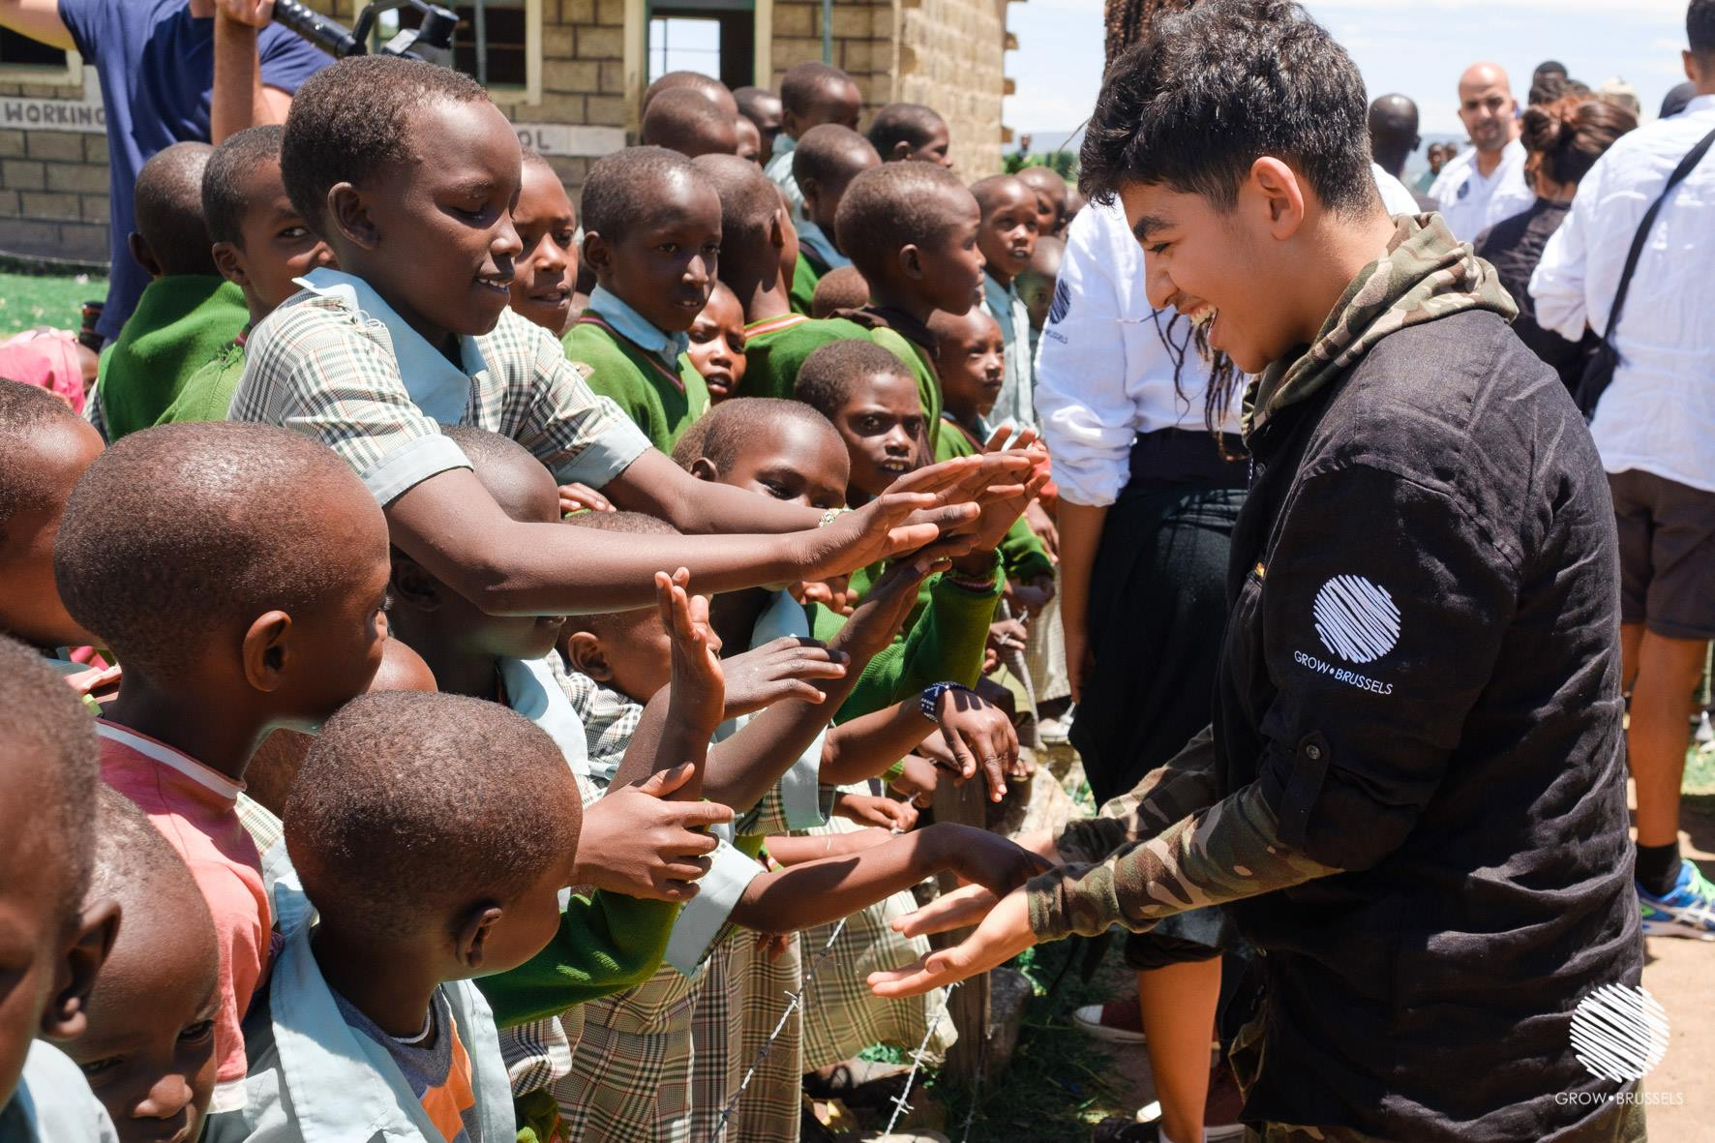
All in all, the system is developing gradually and becoming richer as time goes by?
Yes, absolutely. And we gradually realised, as we broadened the scope and density of the young people's missions and also involved young people from the destinations visited, that the destination was no longer in itself the only guarantee of emotional 'shock'. But that the inspiring beauty of a place, the nobility and human warmth and the strength of the discoveries were not exclusively linked to the distance of the trip, nor to its intrinsic exoticism, nor to the landscapes alone, but that there could also be equally inspiring discoveries that were less distant and therefore less expensive. Like Tunisia, for example. But also in France and around the Mediterranean. Even in Belgium. Focusing the mission on environmental issues and ecotourism-related professions opens up new horizons for MOVE for THE WORLD. Young people are ready to "get moving" on real issues as soon as they can discover, in addition to an aesthetic emotion beyond their usual horizons, a reason for being.

Slide 65





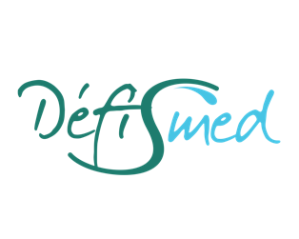

This project is the fruit of the brainstorming of 7 partners from France, Ireland, Italy, Belgium and Sweden.
Our team
LE LABA
W8
MOMENTUM MARKETING SERVICES
COOMPANION
MATERAHUB
DEFISMED
https://ecohealthforyouth.com
OIRD
OIRD

Slide 66






https://ecohealthforyouth.com
GOOD PRACTICES GUIDE
Follow our journey

